Slide 1
CONSEF
Application process
www.consef.org

Slide 2
CONSEF - Deadlines
Design Contest: Dec 14, 2018 Early Bird School Registration: Dec 14, 2018 ($100) Late registration: Feb 22, 2019 ($160) SRC Application: Feb 8, 2019 Student Application Deadline: Feb 22, 2019. Announcement of the CONSEF-Qualifiers: March 1, 2019 Day of the Event: April 6, 2019

Slide 3
CONSEF Application process
Step 1: Register your school
1
Step 2: Create Teacher/Mentor Accounts
2
Step 3: Create Student Accounts
3
Step 4: Student applications
4
Final: Preselection
5

Slide 4
Register your School
Open your school account
Pay the registration fee
Print out the invoice

Slide 5
CONSEF-Registration Fee
Early Bird School Registration: Dec 14, 2018 - $100
Late registration: Feb 22, 2019 - $160

Slide 6
Add teachers
Add students
Share responsibilities with other teachers
Create teacher accounts
Teachers will have opportunities to go over their students’ application.
Create student accounts.
Pass the student information to your students
Have them fill out their applications
Teacher/Coordinator has privilege to edit the students’ information.

Slide 7
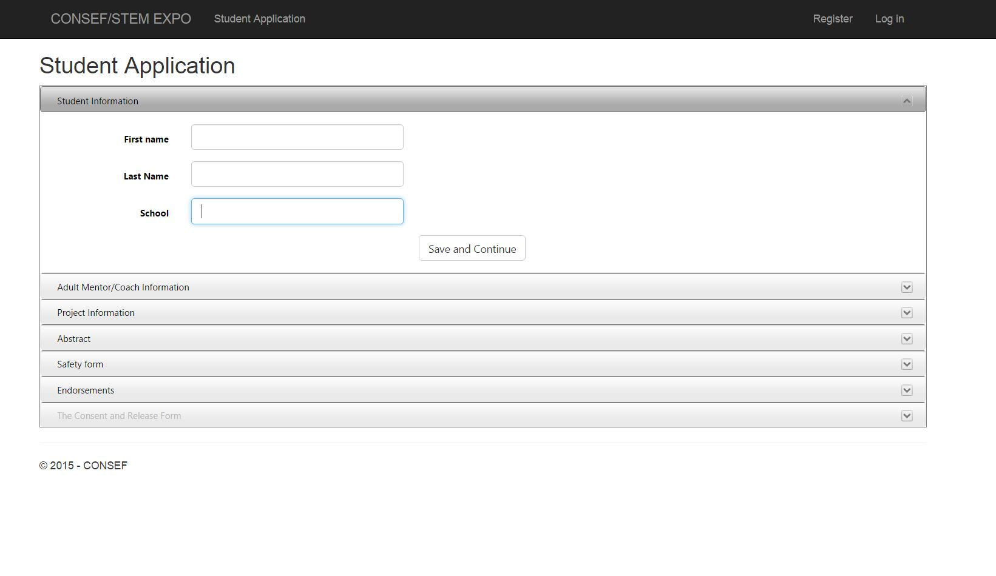
STUDENTS
APPLICATION
Save and edit later.
Student information
Adult Mentor information
Project information
Abstract
Safety form
Endorsement

Slide 8
Categories
Project Type
Design Project
Experimental Project
Categories
Behavioral Science
Botany
Biochemistry…………..

Slide 9
Special judging
Genius Olympiad
9-12
Apply for Genius Olympiad Judging
Judges’ Special Award
Recycling and Renewable Energy Resources

Slide 10
Awards
Category Awards
Gold, Silver, Bronze
Best of the Category
Special Awards
Genius Olympiad nominee
Judges’ Special Award- $150

Slide 11
Approve/Submission process
Review the students’ applications and approve them for the further steps.
Attach the students’ Consent and Release form.
Coordinators are the only people who can submit the student applications to CONSEF for the preselection process.

Slide 12
Preselection Criteria
Scientific Approach
Experimental/Design Approach
Validity of Conclusion
Originality
http://www.consef.org/?p=3319

Slide 13
CONSEF- Rules
Team projects are not accepted.
CONSEF is open to any student from grades 5-12.
Each individual student cannot participate in both STEM EXPO and CONSEF.
Each indivual can participate in both Math Olympics and STEM EXPO or CONSEF and Math Olympics.
Pre-selection: All projects are subject to a pre-selection process based on the criteria listed on http://www.consef.org/?p=3319.

Slide 14
Science Fair Pathway
International Science Fairs
STATE SCIENCE FAIR/CONSEF
REGIONAL SCIENCE FAIR
IN-SCHOOL SCIENCE FAIR

Slide 15
Title of the Project | Division | Purpose/Problem: | Hypothesis/Approach:
Mentos And Coke Challenge | Junior (5-8) | To See The Reaction Of What Happens When I Mix Mentos And Coke | The Coke Will Explode With The Mentos

Slide 16
Title of the Project | Division | Purpose/Problem: | Hypothesis/Approach:
Rubber Bands and Energy | Junior (5-8) | My ruler’s angle might not have been the same every time so that may have messed up my results. | If I pull back on the rubber band farther than the rubber band will fly farther.

Slide 17
Title of the Project | Division | Purpose/Problem: | Hypothesis/Approach:
Can milk be turned into plastic?! | Senior (9-12) | The point of this experiment was to see if milk could be turned into a plastic. | If it is believed that margarine, a product of milk and butter, which another product of milk can be turned into plastic, then milk it's self can be turned into plastic.

Slide 18
Title of the Project | Division | Purpose/Problem: | Hypothesis/Approach:
The power of bleach | Senior (9-12) | I wanted to see what will happen when I put the food coloring inside the bleach | I think that when I put the food coloring inside the bleach it will turn clear

Slide 19
Title of the Project | Division | Purpose/Problem: | Hypothesis/Approach:
Heavy Metals and Aquatic Environments | Junior (5-8) | The purpose of this project is to observe which common heavy metal has the largest effect on aquatic ecosystems. | The experimenter's hypothesis is that nickel chloride would have the biggest impact on plants, since it is the most toxic out of the heavy metals used, and it's also the least naturally occurring.

Slide 20
Title of the Project | Division | Purpose/Problem: | Hypothesis/Approach:
The effects of anti inflammatory medicines (nsaid) on liver cells/tissue | Junior (5-8) | My parents were concerned about the side effects and therefore I decided to study how NSAID’s affects your liver tissue/cell. | Since my doctors recommended to take Diclofenac after other OTC (over the counter) medicines, I believe Diclofenac has the most damage on the liver tissue/cell.

Slide 21
Title of the Project | Division | Purpose/Problem: | Hypothesis/Approach:
What Materials Block Radio Waves? | Junior (5-8) | My purpose was to see if different materials will block radio waves. | My hypothesis is that foil will block the radio waves the most.

Slide 22
Title of the Project | Division | Purpose/Problem: | Hypothesis/Approach:
What Materials Block Radio Waves? | Junior (5-8) | My purpose was to see if different materials will block radio waves. | My hypothesis is that foil will block the radio waves the most.

Slide 23
IRB
I am using spin tests to discover how important your eyes and ears are in balance and dizziness. I will compare how each volunteer reacts to being spun around in each test to see if the are similar or different.
VIOLATIONS

Slide 24
SRC
The purpose of this experiment is to see which grades has most germs their phone screen.
……
Use q-tips to wipe the screen of the cellphone.
Wipe the q-tip in zig-zag pattern on to the petri plate.
Place all the dishes in a dark, room-temperature place like a closet.
It will take about 3-7 days for the germs to appear...
VIOLATIONS

Slide 25
SRC
I'm experimenting the response time that different animals have when encountering a human. Many animals are capable of seeing a human from a distance since their eyes are located on each side of their face.
VIOLATIONS

Slide 26
Any project involving human subjects require prior IRB approval before experimentation.
IRB APPROVAL
Constitute an IRB at your school
IRB - Institutional Review Board which at least consists of one medical profession, one science teacher, and one school administrator
Students need to
Fill out Human Subject Form (4) for each human subject they are testing and submit it IRB chair.
IRB chair should sign Approval Form (1B) part 2a
Lack of this Endorsement may result in disqualification.
Notes:
Some students work on some advanced project. In this case, proper approval should be taken.
First of all, Each school needs to constitute a Review Board at the school. Doctors, school nurse, Social workers, or a parent with medical background can be in this board.

Slide 27
SRC APPROVAL
Any project involving
non-human vertebrate animals,
pathogenic agents
bacteria and fungi
controlled substances,
recombinant DNA,
human and non-human vertebrate animal tissue
require prior SRC (Science Review Committee) approval.
Students are required to do their research under the supervision of a qualified scientist and/or conducted the research in a university, a medical/research facility or an industrial institution.

Slide 28
SRC APPROVAL
Two ways to get the SRC approval
1- Universities/colleges
Have the SRC chair sign the Approval Form (1B) part 2a.
2- Send us the forms to get the SRC approval.
Notes:
Some universities or colleges have Science Review Committee, so we accept their approval. In this case the SRC chair should sign Approval form part 2a. If this is not a case, students should send their application along with the other required form to us to get SRC approval before the experimentation. You should hear by phone or e-mail from CONSEF within 2 weeks of submitting your forms. The approval form will be mailed back to you and it must be presented during the fair.

Slide 29
Fill out additionally,
SRC APPROVAL
Research Institutional/Industrial Setting Form (1C)
Qualified Scientist Form (2)
Designated Supervisor Form (3)
Lack of this Endorsement may result in disqualification.

Slide 30
ADDITIONAL FORMS
….and additionally for non-human vertebrate animals
fill out Form (5),
human and non-human vertebrate animal tissue,
fill out Form (6)

Slide 31
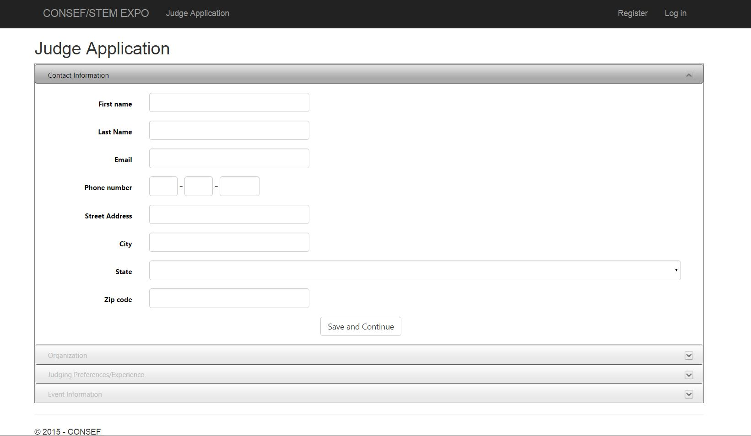
Judges
FILL OUT APPLICATIONS
Coordinators can see the judges from your school

Slide 32
PROJECTS
OVERALL IMPRESSION 51 points
DISPLAY 16 points
ORAL PRESENTATION 20 points
WRITTEN REPORT 13 points
TOTAL 100 points
Judging Criteria

Slide 33
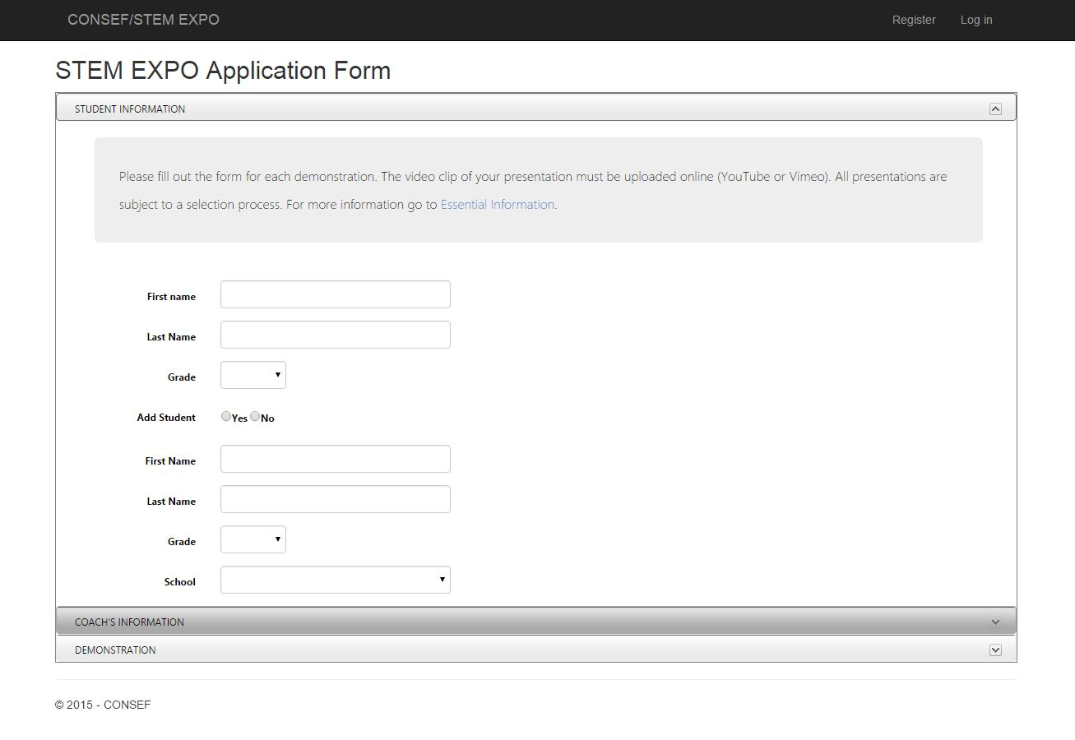
STEM EXPO Coordinators/ Teachers
Fill out student applications

Slide 34
STEM EXPO - Deadlines
Video Submission Deadline: Jan 26, 2019 Announcement of the Qualifiers: Feb 9, 2019 Safety Form and Consent/Release Form: Feb 22, 2019 Day of the Event: April 6, 2019

