Slide 1



BINARY CODING

Slide 2
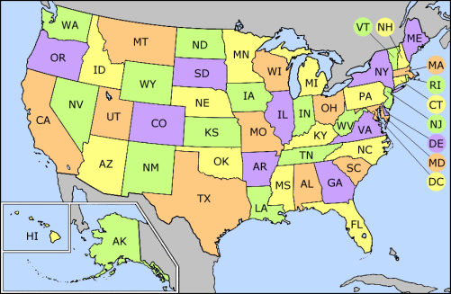
Alabama
Arizona
California
Connecticut
Florida
Hawaii
Illinois
Iowa
Kentucky
Maine
Massachusetts
Minnesota
Missouri
Nebraska
New Hampshire
New Mexico
North Carolina
Ohio
Oregon
Rhode Island
South Dakota
Texas
Vermont
Washington
Wisconsin
0

Slide 3
Montana
Nebraska
New Jersey
New Mexico
North Dakota
Ohio
Pennsylvania
Rhode Island
Tennessee
Texas
Virginia
Washington
Wyoming
Alaska
Arizona
Colorado
Connecticut
Georgia
Hawaii
Indiana
Iowa
Louisiana
Maine
Michigan
Minnesota
1

Slide 4
New Hampshire
New Jersey
New Mexico
Oklahoma
Oregon
Pennsylvania
Rhode Island
Utah
Vermont
Virginia
Washington
Arkansas
California
Colorado
Connecticut
Idaho
Illinois
Indiana
Iowa
Maryland
Massachuset
Michigan
Minnesota
Nevada
2

Slide 5
Delaware
Florida
Georgia
Hawaii
Idaho
Illinois
Indiana
Iowa
Mississippi
Missouri
Montana
Nebraska
Nevada
New Hampshire
New Jersey
New Mexico
South Carolina
South Dakota
Tennessee
Texas
Utah
Vermont
Virginia
Washington
3

Slide 6
Kansas
Kentucky
Louisiana
Maine
Maryland
Massachusetts
Michigan
Minnesota
Mississippi
Missouri
Montana
Nebraska
Nevada
New Hampshire
New Jersey
New Mexico
West Virginia
Wisconsin
Wyoming
4

Slide 7
New York
North Carolina
North Dakota
Ohio
Oklahoma
Oregon
Pennsylvania
Rhode Island
South Carolina
South Dakota
Tennessee
Texas
Utah
Vermont
Virginia
Washington
West Virginia
Wisconsin
Wyoming
5

Slide 9

TENNESSEE = 42
IT DOES NOT EXIST IN FIRST SLIDE(Slide O)
IT EXISTS IN THE SECOND SLIDE(Slide 1), and so on.

