Slide 1

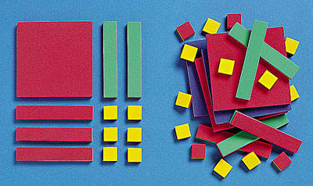
ALGEBRA TILES

Slide 2
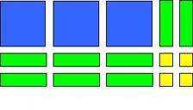


Slide 3
Zero Pairs
When put together, zero pairs cancel each other out to model zero.

Slide 4
Section 6. Doing linear equations
Solve 4x – 3 = 9 + x
=
You can take away the same thing from both sides

Slide 5
Section 6. Doing linear equations
Solve 4x – 3 = 9 + x
=
You can add the same quantity to both sides

Slide 6
Section 6. Doing linear equations
Solve 4x – 3 = 9 + x
=

Slide 7
Section 6. Doing linear equations
Solve 4x – 3 = 9 + x
=
=
=

Slide 8
Section 6. Doing linear equations
Solve 4x – 3 = 9 + x
=
=
=
Solution x = 4

Slide 9
Multiplying & Factorising
General Aim
Whether multiplying or factorising, the general aim is to generate a rectangle and have no pieces left over.
Also the small squares always go in the bottom right hand corner

Slide 10
Section 4. Multiplying in algebra
Example 2. Multiply (x-1)(x-3)
Answer: x²-4x+3

Slide 11
How it works
Show (x+1)(x+3) by arranging the tiles in a rectangle.
x
+
3
Now Arrange them into a Rectangle
Remember the little guys go in the bottom right corner
x
+
1
Rearrange the tiles to show the expansion:
x ² + 4x + 3
Notes:
For weaker pupils you may need to write 1 x 1 on the tiles and the same for the others.
The exercise helps to demonstrate the re-union of broken parts.

Slide 12
Factorise x²+6x+8
Factorise x ² + 6x + 8
x ² + 6x + 8
To factorise this expression form a rectangle with the pieces.
x
+
4
x
+
2
The factors are
( x + 4 )( x + 2 )

Slide 13
Factorise x²-4x+3
Factorise x ² - 4x + 3
x²
- 4x
+ 3
x - 3
x - 1
The factors are
( x - 3 )( x - 1 )

Slide 14
Factorise x²-x-12
Factorise x ² - x - 12
x²
- x
-12
?
Clearly there is no way to accommodate the 12 small guys in the bottom right hand corner. What do you do?
You add in Zero in the form of +x and –x.
And Keep doing it to complete the rectangle.

Slide 15
Factorise x²-x-12
Factorise x ² - x - 12
x - 4
x + 3
The factors are ?
( x + 3 )( x - 4 )

