Slide 1
Countdown Math Competition
http://www.youtube.com/watch?v=pfa3MHLLSWI
http://www.youtube.com/watch?v=rteww8eyplQ

Slide 2
The contestant selects six of 14 shuffled tiles. (next slide)
The tiles are arranged into two groups: four "large numbers" (25, 50, 75 and 100) and the remainder "small numbers", which comprise each of the numbers 1 to 10.
The contestant chooses two large numbers are in the selection and four small numbers.
A random three-digit target is generated by an electronic machine.
The contestants then have sixty seconds to get as near to the target as possible by combining the six numbers selected using addition, subtraction, multiplication and division.
Not all numbers need to be used. A number can be used as many times as it appears.
Fractions are not allowed—only positive integers may be used at any stage of the calculation.
10 points are given for an exact answer.
9 points for non-exact solution up to 1 from the target.
8 points for non-exact solution up to 2 from the target.
7 points for non-exact solution up to 3 from the target.
6 points for non-exact solution up to 4 from the target.
…….
1 point for non-exact solution up to 9 from the target.
If the contestant cannot get within 10, no points are awarded.

Slide 3

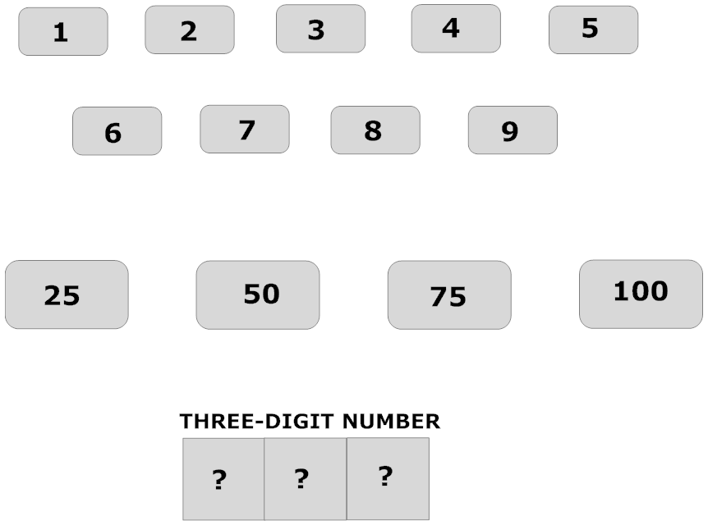


Slide 4
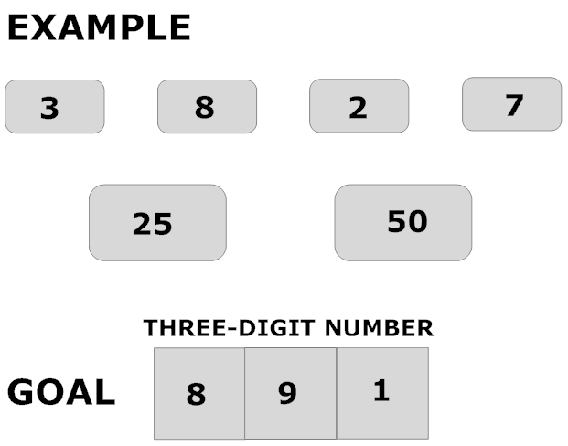
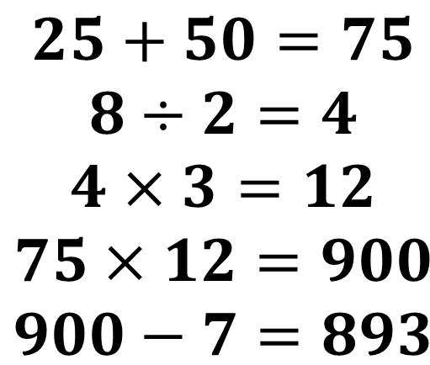
$$\begin{matrix}25+50=75 \\ 8÷2=4 \\ 4×3=12 \\ 75×12=900 \\ 900−7=893\end{matrix}$$
The contestant gets 8 points

