Slide 1
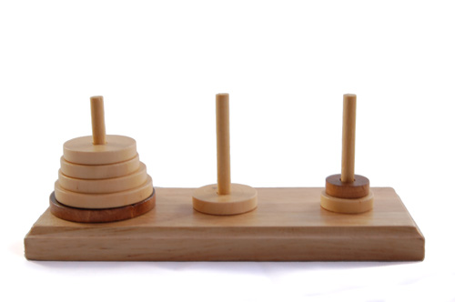
Hanoi Towers
The objective is to transfer entire tower A to the peg B, moving only one disk at a time and never moving a larger one onto a smaller one.
What is the formula for n disc?

