Slide 1
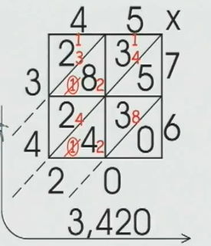
Lattice Multiplication
Low Stress
Near Error Free
Diagnostic Way to Multiply

Slide 2
