Slide 1

THINK OUTSIDE THE BOX PROBLEMS-Kids love them.
I guess you didn't know this:
Letters 'a', 'b', 'c' do not appear
anywhere in the spellings of 1 to 999.

Slide 2

1-2+3-4+5-6+7…-99+100?

Slide 3
1- 2 + 3 – 4 + 5 – 6 + 7…+ 99 - 100=
=(1-2) + (3- 4) + (5 - 6) + (7- 8)…+ (+ 99-100)
=(-1) + (-1) + (-1) + (-1) +…+ (-1)
= -50

Slide 4

There are three types of mathematicians:
Those who can count and those who can't.

Slide 5
If radius of pizza is "z" & thickness is "a", the volume of the pizza will be pi*z*z*a.

Slide 6
Question: Where does a Bee go to the bathroom?
Answer: A BP station.

Slide 7
What did one math book say to the other?
Don't bother me I've got my own problems!

Slide 8
Did you know that 5 out of every 4 people have a problem with fractions?

Slide 9
Funny answers from students!

Slide 10
Funny answers from students!
Expand (a + b)^{n}.
(a + b)^{n}
(a + b)^{n}
(a + b)^{n}
(a + b)^{n}

Slide 11
Funny answers from students!

Slide 12
Funny answers from students!

Slide 13

A doctor gives you three pills telling you to take one every half hour.
How many minutes would the pill last?

Slide 14
A lily pad doubles in size each day.
In 20 days the lily pad will cover the entire pond.
In how many days will the pond be half covered?

Slide 15
19 days.
The lily pad doubles in size in one day, so one day ago it was half the size it is now. If today it covers the entire pond, yesterday it covered half the pond.
Since today is day 20, yesterday is day 19.

Slide 16
Find the last two letters below.
F T L T ? ?

Slide 17
Find The Last Two letters below.
F T L T L B

Slide 18
What are the next two letters in this pattern?
  wo, hr, ou, iv, ix, ??

Slide 19
  Two, Thr, Fou, Fiv, Six, EV

Slide 20
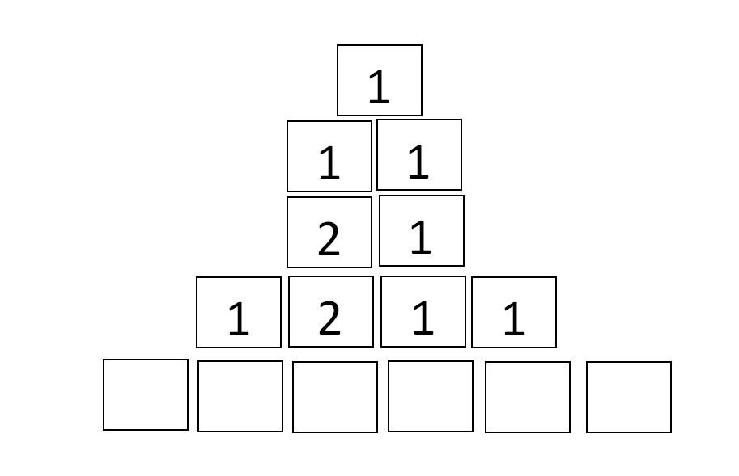
What row of numbers comes next?

Slide 21

The first row - 1 - contains one 1 -> 11
11 contains two 1's -> 21
21 contains one 2, one 1 ->1211
1211 contains one 1, one 2, two 1's ->111221,etc.,
Building on that theory, it would go
111221 contains three 1's, two 2's, one 1-> 312211

Slide 22
