Slide 1

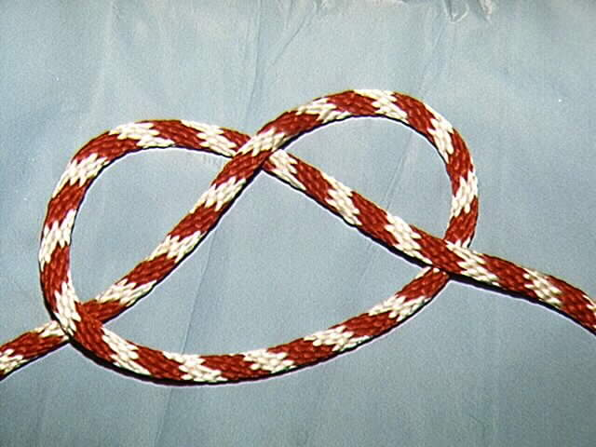
ROPE ACTIVITY- THINK OUTSIDE THE BOX

