Slide 1
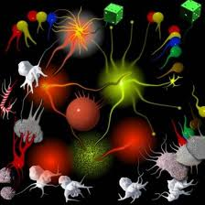
Math-magic Show

Slide 2
A Few Instructions
Some tricks directed to the audience
Most will involve one or more assistants
A random method for selection
Your applause will be my indicator
Card trick vocabulary: to “square a deck”
And please turn your cell/smartphones off

Slide 3
A few warm-ups to…
check if you are still
digesting your lunch

Slide 4
Octagon Magic: Spatial Sense
The audience

Slide 5
Some of you are still digesting…

Slide 6
We need another warm-up

Slide 7
This Time: Number Sense
The audience
1000

Slide 8
40

Slide 9
1000

Slide 10
30

Slide 11
1000

Slide 12
20

Slide 13
1000

Slide 14
10

Slide 15
…equals what?

Slide 16
Let’s look more closely…
1000
40
1000
30
1000
20
1000
10
????

Slide 17
YES!!!
1000
40
1000
30
1000
20
1000
10
4100

Slide 18
You’re still not ready for the show
But you’re still having fun, right?

Slide 19
One More Spatial Sense Warm-Up
1 | 2 | 3 | 4 | 5 | 6 | 7 | 8 | 9 | 10

Slide 20
Bookworm Problem
A 10-volume encyclopedia sits on a shelf. Each volume is 4 cm thick. Suppose a book-worm starts at the front cover of Volume 1 and eats his way in a straight, horizontal line to the back cover of Volume 10.

Slide 21
How far does the book-worm travel?
1 | 2 | 3 | 4 | 5 | 6 | 7 | 8 | 9 | 10
Que distancia viaja/recorre?

Slide 22
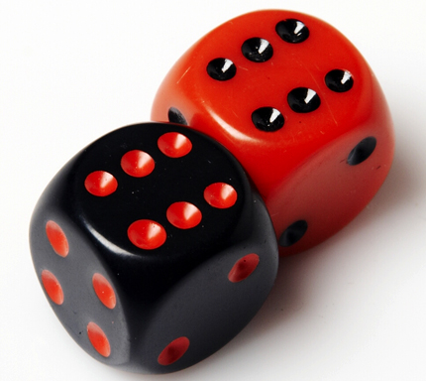
Last One: But you have to be quick!

Slide 23
One die – Two dice

Slide 24
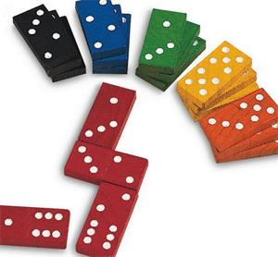
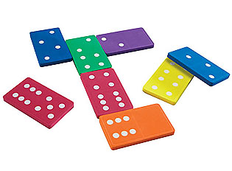

Slide 25
One domino – Two dominoes

Slide 29
Very good !

Slide 30
Magic Domino Card

Slide 31
I will guess your number
1 assistant
  1 2 3 4 5 6 7
  8 9 10 11 12
  13 14 15 16 17
  18 19 20 21 22 23 24
  25 26 27 28 29 30
Pick a number, write it down, show it to the audience, then place the board face down

Slide 32
Do you see the number here?
20 21 22 23
28 29 30
17 18 19
24 25 26 27
YES or NO?

Slide 33
What about here?
12 13 14 15
8 9 10 11
28 29 30
24 25 26 27
YES or NO?

Slide 34
And here?
12 13 14 15
4 5 6 7
28 29 30
20 21 22 23
YES or NO?

Slide 35
Here?
10 11 14 15
2 3 6 7
26 27 30
18 19 22 23
YES or NO?

Slide 36
And finally, here?
9 11 13 15
25 27 29
1 3 5 7
17 19 21 23
YES or NO?

Slide 37
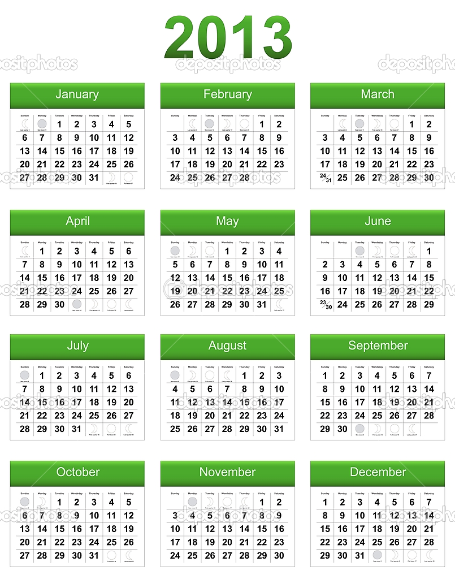
Calendar Magic
1 assistant

Slide 38
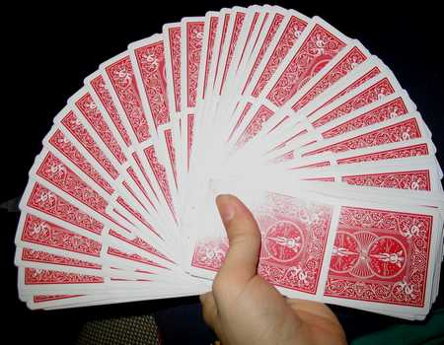
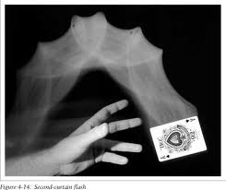
The Flying Card
1 assistant

Slide 39
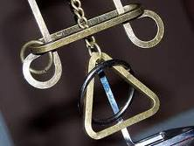
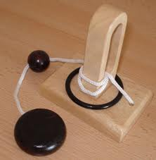
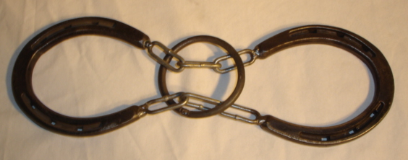
Ring Puzzles
The audience

Slide 40
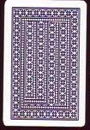
I will halve what you have
1 assistant

Slide 41
I will guess your Numbers!
3 assistants
Pick a whole number between 100 and 300
  It can’t be 100 and it can’t be 300

Slide 42
Secret Move
2 assistants
13 identical objects

Slide 43
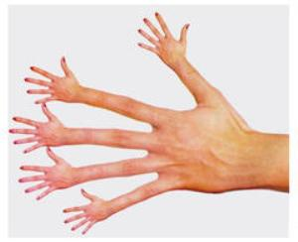
Magic Touch…

Slide 44
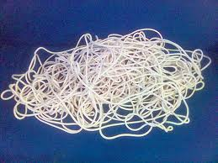

The Magic Rope

Slide 45
Thank you very much!
MonicaNeagoy@earthlink.net

Slide 46
An Encore?

Slide 47
Thank you very much!
Gracias

Slide 48

12. Finale: Double Magic
The mathematician’s way
then…
The magician’s way
Spades Hearts Diamonds Clubs

Slide 49
I will halve what you have
1 assistant

Slide 50
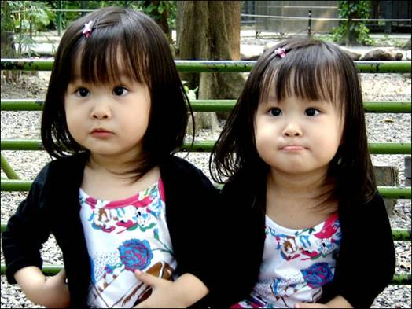
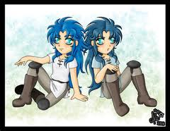

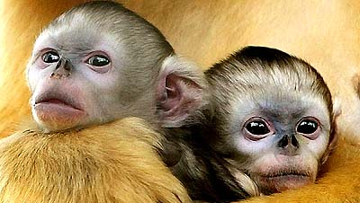
Magical Twins (Tweelingen)
1 vrijwilliger

Slide 51
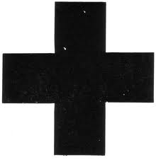
I will predict your sum
Begin by placing digits 1, 2, 3, 4, 5, 6, 7, 8, and 9 in any nine cells, in any order Then we will add three more digits

Slide 52
Ik dank u weer van harte
voor uw aandacht en deelname
MonicaNeagoy@earthlink.net

Slide 53
Quick test to check if you are still awake…
1000

Slide 54
40

Slide 55
1000

Slide 56
30

Slide 57
1000

Slide 58
20

Slide 59
1000

Slide 60
10

Slide 61
equals?

Slide 62
Let’s look more closely…
1000
40
1000
30
1000
20
1000
10
????

Slide 63
1000
40
1000
30
1000
20
1000
10
4100!

Slide 64
Ik dank u Veer van harte voor uw aandacht en deelname
MonicaNeagoy@earthlink.net

Slide 65
Bookworm Problem
1 | 2 | 3 | 4 | 5 | 6 | 7 | 8 | 9 | 10

Slide 66
Bookworm Problem
A 10-volume encyclopedia sits on a shelf. Each volume is 5 cm thick. Suppose a book-worm starts at the front cover of volume 1 and eats his way in a straight, horizontal line to the back cover of volume 10.
Une encyclopédie à 10 volumes est sur une étagère. Chaque volume a une épaisseur de 5 cm. On suppose qu’un petit ver commence à la couverture du volume 1 et parcourt une ligne droite et horizontale jusqu’au dos de la couverture du volume 10.

Slide 67
Bookworm Problem
1 | 2 | 3 | 4 | 5 | 6 | 7 | 8 | 9 | 10
How far does the book-worm travel?
Quelle distance parcourt le petit ver?

Slide 68
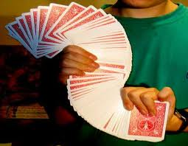
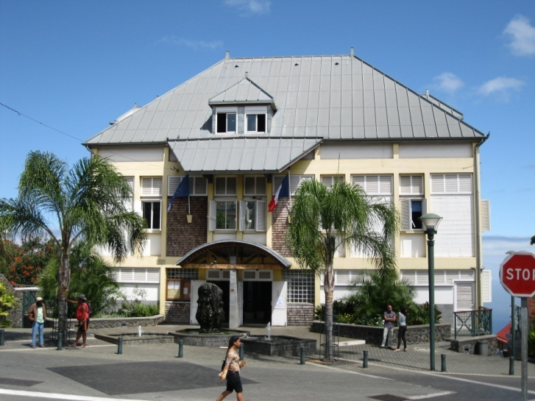
Bilingual Card Trick

Slide 69
0ne
Two
Three
Four
Five
Six
Seven
Eight
Nine
Ten

Slide 70
Domino Magic

Slide 71
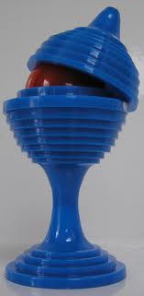
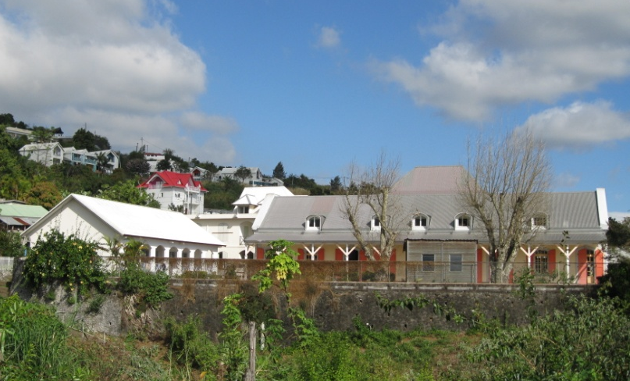
Qu’est-ce que c’est?

Slide 72

De 100 a 300
I will read your mind

Slide 73
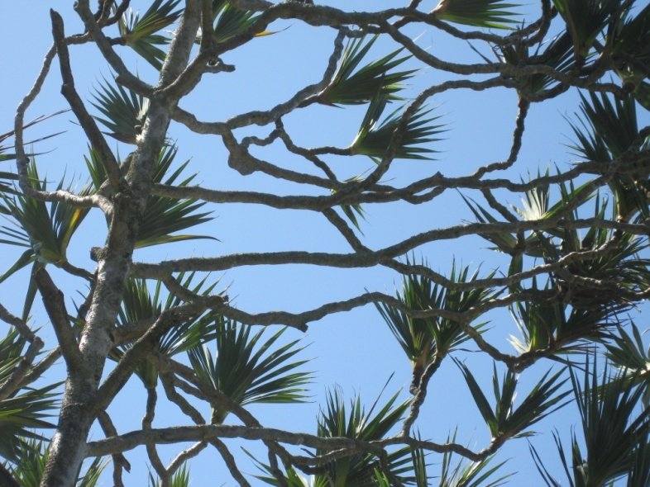
The Magic Cut

Slide 74
I will predict your numbers
Une feuille de papier s’il vous plait …et un moment de silence
1 2 3 4 5
6 7 8 9 10
11 12 13 14 15
16 17 18 19 20
21 22 23 24 25

Slide 75

1 2 3 4 5
6 7 8 9 10
11 12 13 14 15
16 17 18 19 20
21 22 23 24 25

Slide 76
Ik dank u van harte voor uw aandacht en deelname

Slide 77
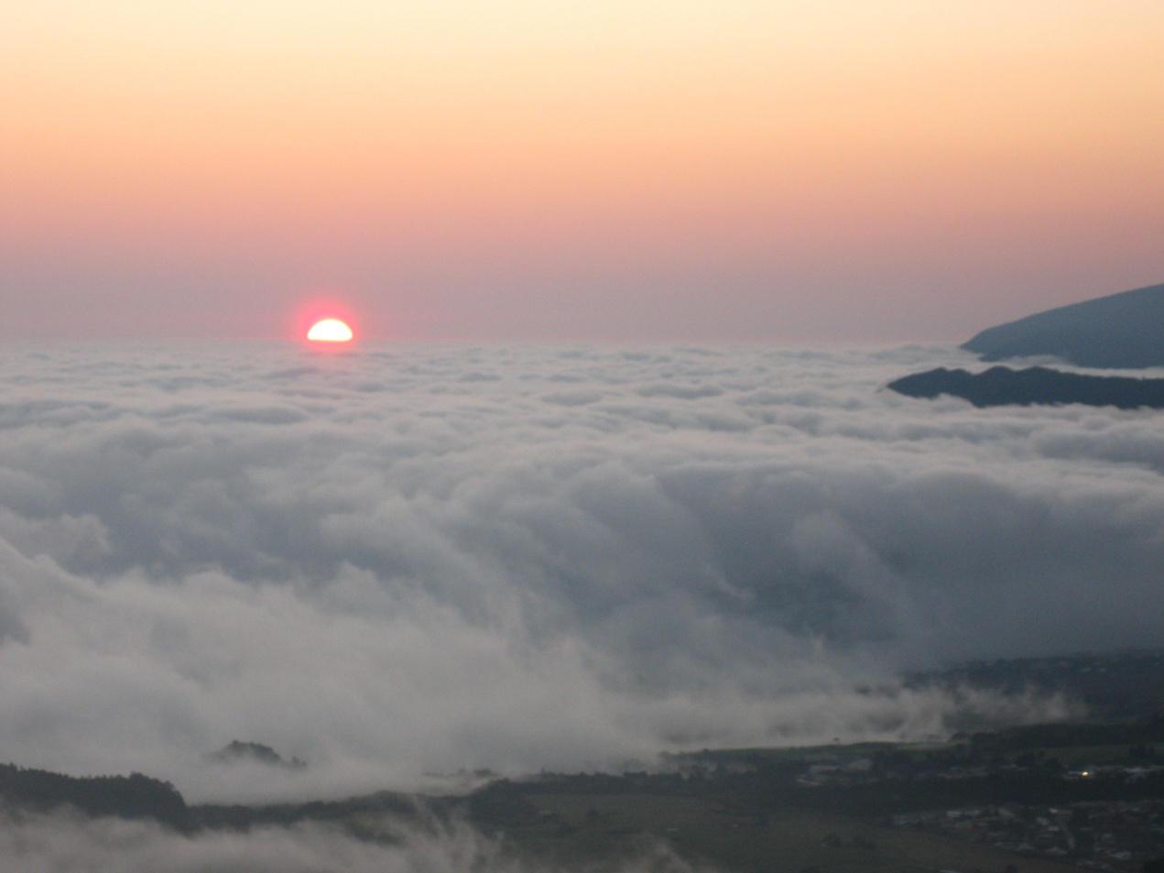
Un dernier tour?

Slide 78
Magic Square
A | B | C | D
C- | D+ | A- | B+
D+ | C+ | B- | A-
B | A-- | D++ | C

Slide 79
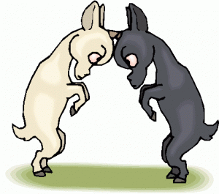
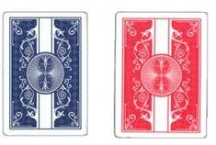
Do As I Do
1 vrijwilliger

Slide 83
5. Bewitched Addition
4 vrijwilligers
7
9
8
6
1
5
6
4
3
7
4
8
5
2
9
6
8
1
7
6
3840 different possible permutations (10 x 8 x 6 x 4 x 2)

Slide 84
Bewitched Addition
4 vrijwilligers
7
9
8
6
1
5
6
4
3
7
4
8
5
2
9
6
8
1
7
6
Once final permutation is chosen, place number strips close together to form four 5-digit numbers

Slide 85
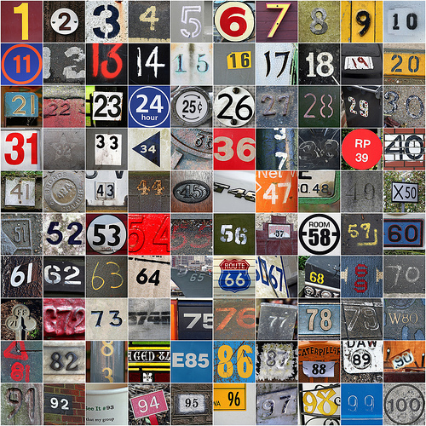
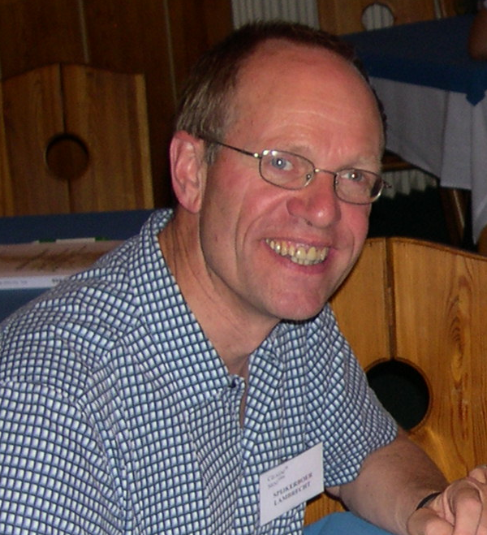
4. Parallel Thinking:
21st-century telepathy
Lambrecht + 4 vrijwilligers
Stage assistance to escort Lambrecht, then me, outside Atrium

Slide 86
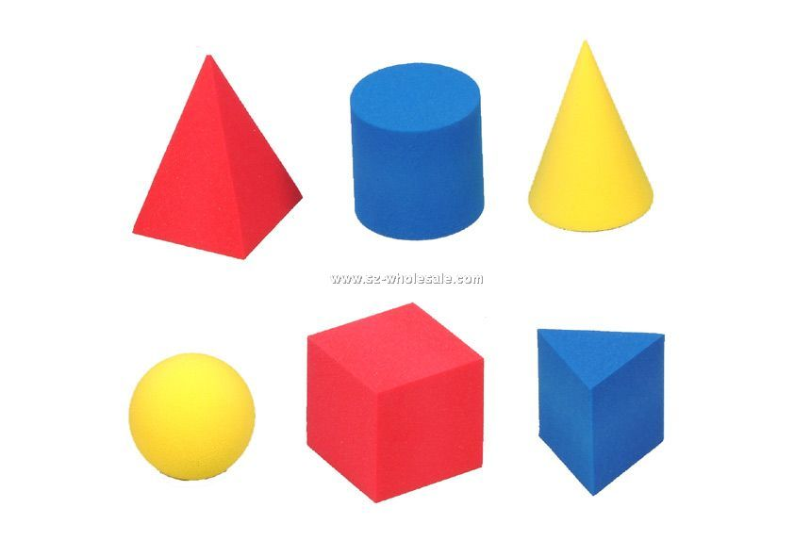

7. 3-Object Divination
1 vrijwilliger
Blindfolding assistance please

Slide 87
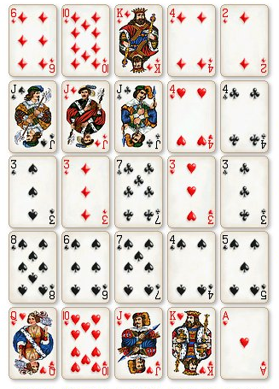
9. Poker Magic
5 vrijwilligers

