Slide 1
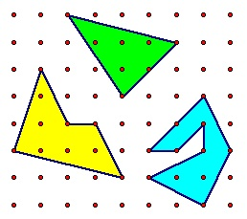
Which of the following has the largest area?

Slide 2
Pick’s Theorem
If there are
m points in the interior of the region
n points on its boundary.
AREA= m + (n/2) - 1
Green area: 5 units=
Yellow area: 6.5 units=
Blue area: 5.5 units=

