Slide 1

stemcon 2015
Making the Right Connections
Dincer Coach
Concept Schools
Join by phone
1-650-479-3208 Call-in toll number (US/Canada)
Access code: 806 646 626
Notes:
NOTE: Want a different image on this slide? Select the picture and delete it. Now click the Pictures icon in the placeholder to insert your own image.

Slide 2
STEMCON-2015
STEM Conference
Project Session
STEM EXPO Demonstrations
Robotic Competitions
April 16-18, 2015

Slide 3
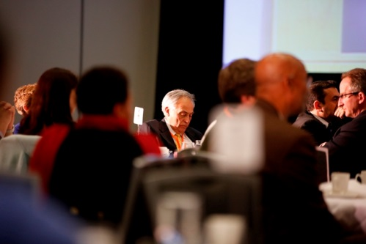
STEMCON: Conference
April 16, 2015
April 17, 2015
AWARDS CEREMONY
DINNER
PANEL
Break-Out Sessions

Slide 4
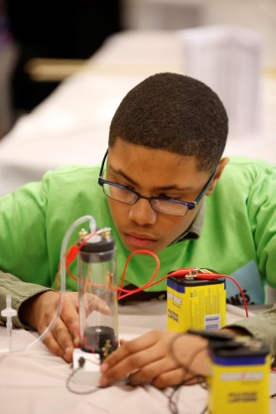
STEMCON: Student Events
April 16, 2015
April 17, 2015
April 18, 2015
Project Session
STEM EXPO
Robotics Competitions

Slide 5
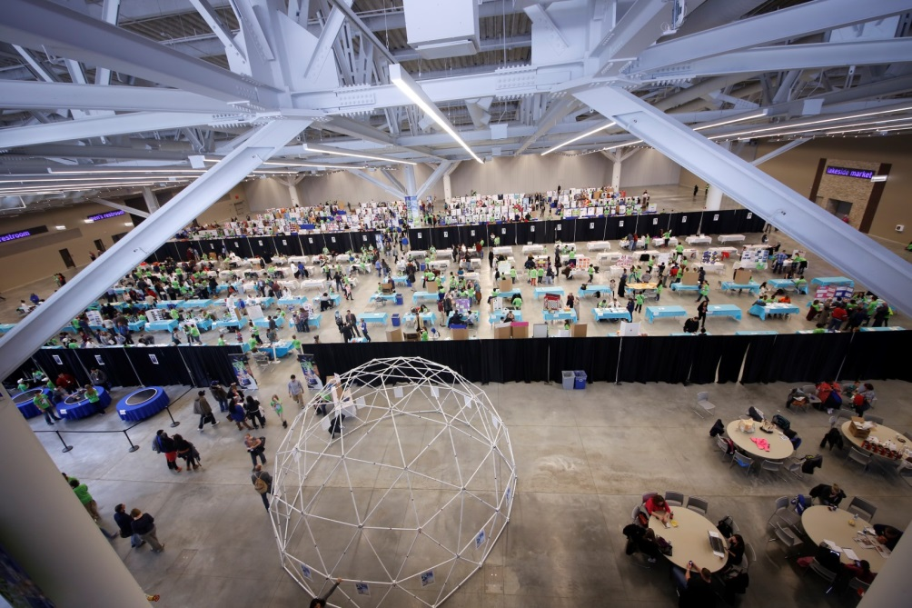
STEMCON: Location
April 16, 17 2015
April 18, 2015
CONFERENCE
Student Events
CLEVELAND CONVENTION CENTER
300 Lakeside Avenue Cleveland, OH 44113

Slide 6
Project Session
Eligibility:
  All public, private, charter, home-school students.
  All students in grades 5 through 12.
  Junior Division: 5th -8th Grades
  Senior Divisions: 9th – 12th Grades

Slide 7
Project Session : Important Dates
School Registration: Aug 1- Dec 19, 2014
SRC Approval Application: Aug 1, 2014- Feb 20, 2015
Project Application: Aug 1, 2014- Mar 6, 2015
Announcement of the selected projects: March 20, 2015
Day of the Event: April 18, 2015

Slide 8
Project Session : Pre-selection
All projects are subject to a pre-selection process based on the criteria listed below.
EXPERIMENTAL PROJECTS
Scientific Approach : Well defined problem was solved using scientific principles.
Experimental Approach: Dependent and independent variables were defined and control group was in evidence.
Validity of Conclusion : Conclusion is consistent.
Originality : Topic is original and method is highly creative.
DESIGN PROJECTS
Design Approach Overall: Has identified a need or real world problem.
Design Approach-Performance Criteria: Clear performance criteria have been developed to address the features of the product, algorithm, proof, model, etc.
Validity of Evaluation/Conclusion : Conclusion accurately reports with the success/failure of the design
Originality: Topic is original and method is highly creative.

Slide 9
School Membership
Be a member
Fill out the School Membership form.
Pay online or,
send money order or checks in the amount of $100 - payable to Concept Schools- per school per division.
$100 fee covers 1-10 students,
If you are planning to participate in CONSEF with more than 10 students, pay $10 more for each additional student.

Slide 10
STUDENT APPLICATIONS
Submission: Science Fair Coordinators and coaches are only the people who can submit the research project to CONSEF 2015. All others must save the document for later approvals.
No hard copies: All forms must be submitted online including the Consent and Release form.
  Download the forms for endorsements, fill them out, and attach them to the online submission form.

Slide 11
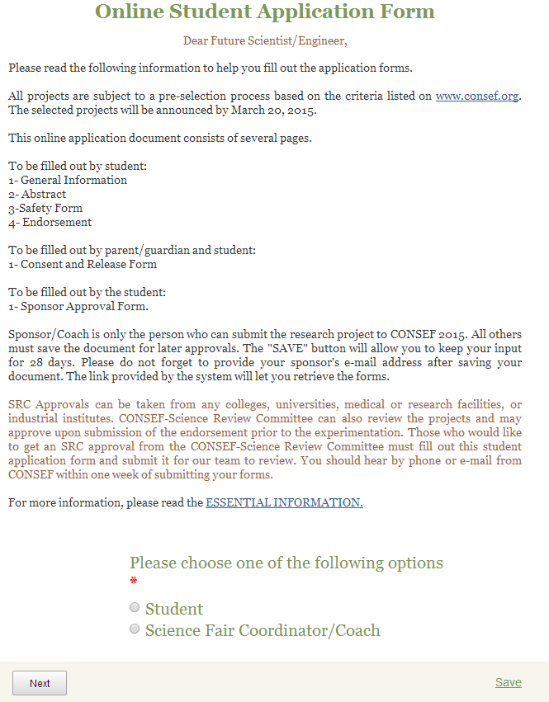
STUDENT APPLICATIONS:
Have your students sign in as a student and fill out the form.

Slide 12
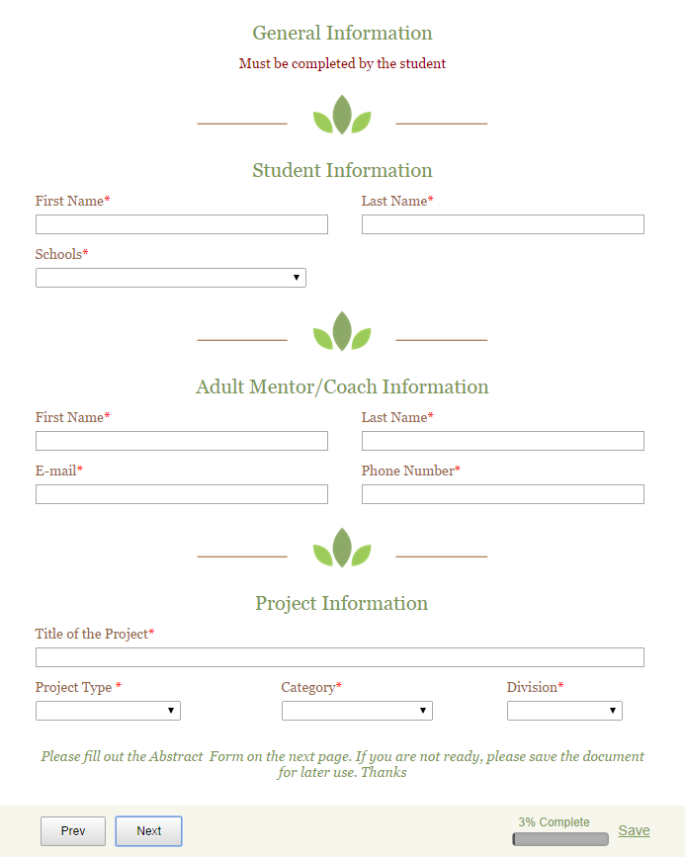
STUDENT APPLICATION:
General Information
Project type
  Design Projects
  Experimental Project
Design Projects:
  If the objective of the project is to invent a new device, procedure, computer program, or algorithm, then the project may fall into the design category.

Slide 13
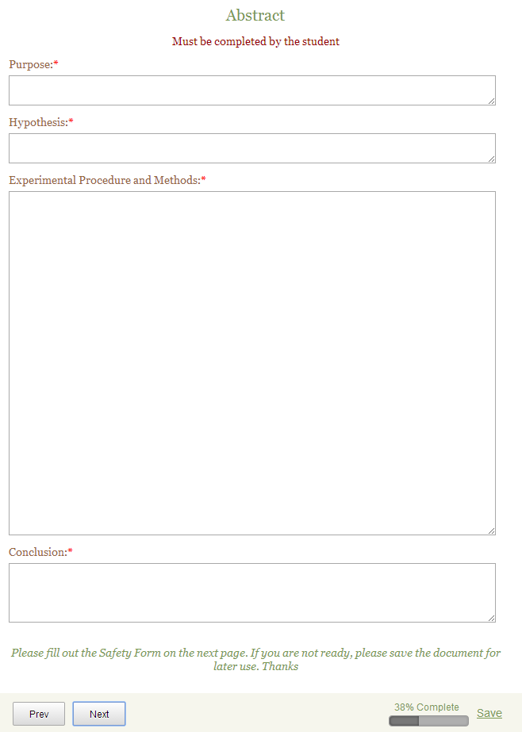
STUDENT APPLICATIONS: Abstract
Pre-selection criteria will be applied in this section.

Slide 14
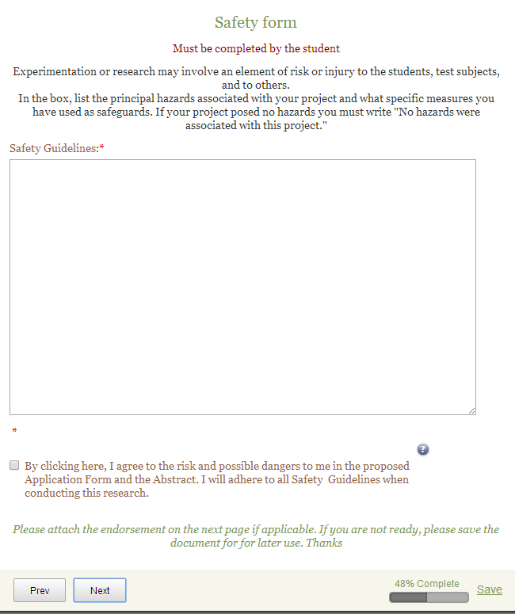
STUDENT APPLICATIONS:
Safety form
Students must agree with the possible hazards that may occur during the experimentation to proceed further.

Slide 15
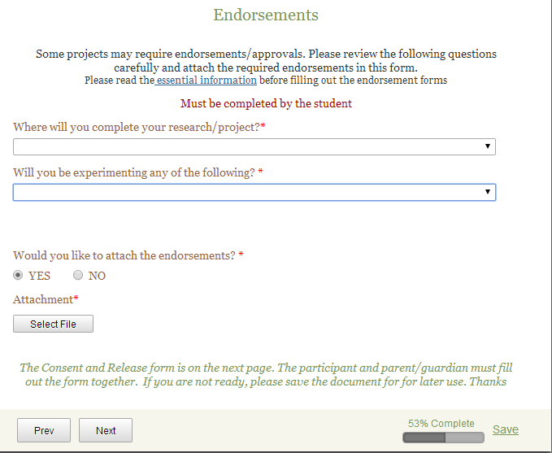
STUDENT APPLICATIONS:
Endorsements
Have your student attach any required endorsement in PDF or picture format.

Slide 16
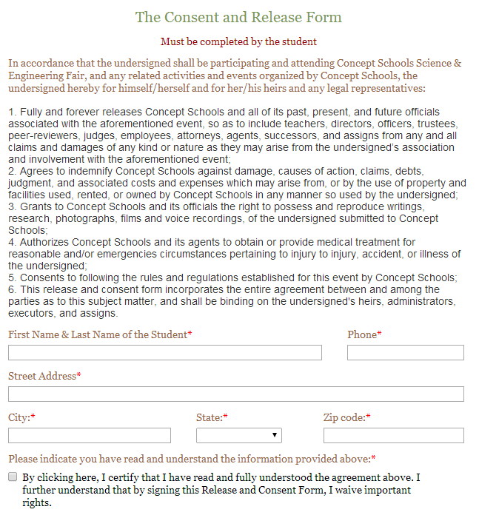
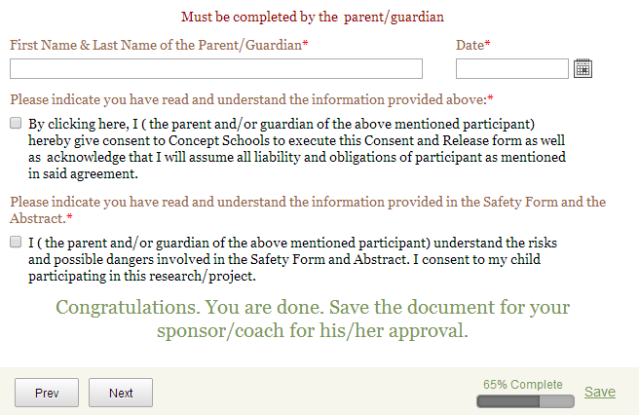
STUDENT APPLICATIONS:
Consent and Release Form
Both must be completed by parent and students.

Slide 17
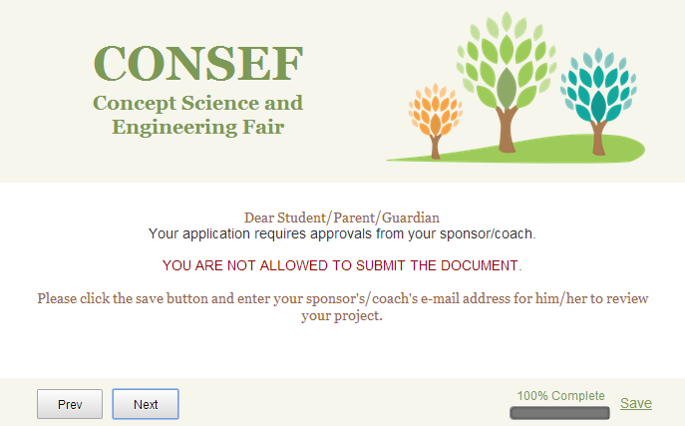
STUDENT APPLICATIONS:
Save vs. Submit
Have your students save the form and enter your email address.

Slide 18
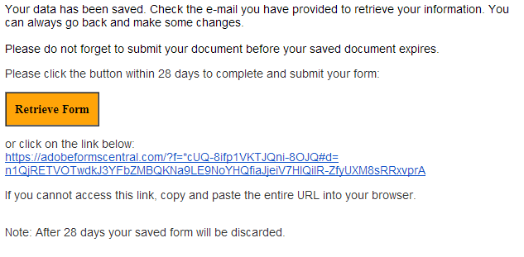
STUDENT APPLICATIONS:
Retrieve the Form
Check your email and retrieve the form to go over the information that your students entered.

Slide 19
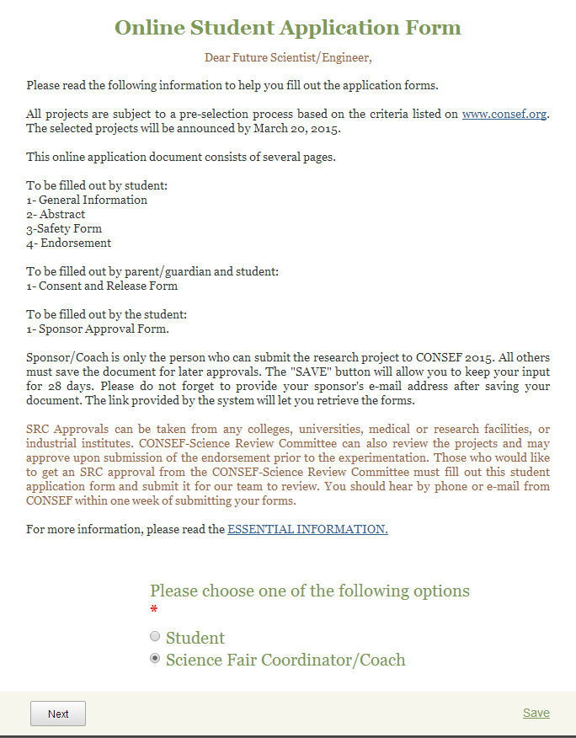
STUDENT APPLICATIONS:
Consent and Release Form
Go back to first page
Sign in as science fair coordinator/coach

Slide 20
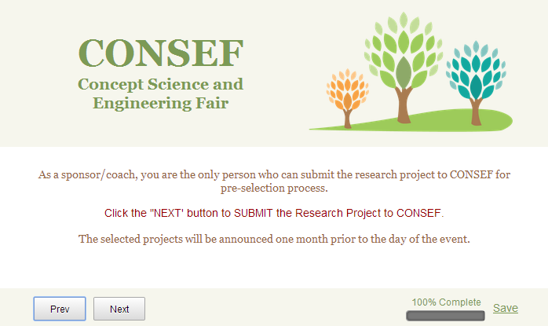
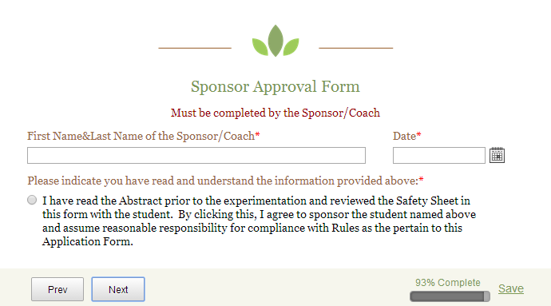
STUDENT APPLICATIONS:
Submit
Review the information
Approve the project and submit it.

Slide 21
SRC- Science Review Committee
Any project involving
non-human vertebrate animals,
pathogenic agents
bacteria and fungi
controlled substances,
recombinant DNA,
human and non-human vertebrate animal tissue
require prior SRC (Science Review Committee) approval.
Students are required to do their research under the supervision of a qualified scientist and/or conduct their research in a university, a medical/research facility or an industrial institution.

Slide 22
SRC- Science Review Committee
1st Case Scenario: In a university, a medical/research facility or an industrial institution
Do the research under the supervision of a qualified scientist and conduct it in a university, a medical/research facility or an industrial institution.
  Have the SRC chair sign the Approval Form7
  Scan the form and attach as PDF or picture format in the application form
Download the Approval form at http://www.consef.org/?page_id=121

Slide 23
SRC- Science Review Committee
  2nd Case Scenario: In a university, a medical/research facility or an industrial institution with a supervisor
Conduct the research in a university, a medical/research facility or an industrial institution.
  Have the SRC chair sign the Approval Form7
  Scan the form and attach as PDF or picture format in the application form
Download the Approval form at http://www.consef.org/?page_id=121

Slide 24
SRC- Science Review Committee
3rd Case Scenario: At the school or at any other facility
Do the research under the supervision of a qualified scientist .
  Apply CONSEF Science Committee to get the SRC Application
  Fill out the student application form and submit it for our team to review.

Slide 25
SRC – Additional forms
  Attach the following forms as PDF (or picture formats in the application form.
  Research Institutional/Industrial Setting Form (1C)
  Qualified Scientist Form (2)
  Designated Supervisor Form (3)
  Lack of this Endorsement may result in disqualification.

Slide 26
IRB- Institutional Review Board
  Constitute an IRB at your school
    IRB - Institutional Review Board which at least consists of one medical profession (School nurse or social workers are acceptable), one science teacher, and one school administrator.
  Any project involving human subjects require prior IRB approval before experimentation.
  Students need to
    Fill out Human Subject Form (4) for each human subject they are testing and submit it IRB chair.
    IRB chair should sign Approval Form 7
    Attach the approval form as PDF or picture format in the application form
  Lack of this Endorsement may result in disqualification.

Slide 27
RULES & REGULATIONS
Each student can participate in CONSEF with only one project.
Team projects are not accepted.
Maximum amount of projects participating in CONSEF are restricted to 20 in each division from each school.
Students can display only their presentation with pictures, drawings, and diagrams. No equipment is allowed during the presentation.
Notes:
Please send us the best projects that were choosen at the school science fair. Students can display only their presentation with pictures, drawings, and diagrams. We used to see some jars, electronic devices, even some patri dishes with bacteria in them. They are not allowed at all.

Slide 28
RULES & REGULATIONS
The participants only in the Computer and Electronic/Engineering categories may bring their personal laptops to present their projects. However, outlets will not be provided.
A research paper must be displayed with your project.
Safety and endorsement sheets must be displayed during the presentation.
Notes:
Students need to make arrangements to have adequate back up power.

Slide 29
JUDGING
The participating schools are required to provide one judge for every two projects
Fill out the application form at
http://www.consef.org/?page_id=128

Slide 30
REPORT
Abstract
Checklist for Adult Sponsor/Safety Assessment Form
Endorsements
Title Page
Table of Contents
Acknowledgments
Purpose and Hypothesis
Review of Literature
Materials and Methods of Procedure
Results
Conclusion
Reference List
Notes:
These are written report requirements. The paper must include the followings in this order. You can learn the other requirements from the Policy and procedure Manual.

Slide 31
DISPLAY BOARD
The display must not exceed the dimensions of 76 cm front to back, 122 cm from side to side, and 152 cm from table to top.
Before judging, all of the displays will be carefully inspected by the safety committee.
A copy of the following papers must also be posted.
  Safety Sheet(s),
  Endorsement(s)/required document (if applicable) must be displayed on the front of the exhibitor’s display board.

Slide 32
AWARDS
Student Awards
Gold : 91-100 points
Silver : 81-90 points
Bronze : 71-80 points
Honorable Mention: 70 or less points
Best of Category:
  The top project of each category from each division wins the “Best of Category” Award.
Notes:
In CONSEF, no one is competing against any other participant. We try to is recognize every student. Participants will be awarded according to their scores given by the judges. Out of three scores, we will be using the highest two scores to get the average. This average score will be the participant's final score to designate the prize
If a student get a point between 91-100 it is a gold medal.

Slide 33
AWARDS
School awards:
Best School Award
  The school receiving the highest average of their top 5 projects wins the “Best School Award” in each division
  Schools participating in CONSEF with less than 5 projects will not be considered in this category.

Slide 34
DESIGN CONTEST
Participation:
Grades 5 -12 (Member schools)
All entries must be postmarked no later than December 19, 2014.
Send the applications:
Dincer Coach
Concept Schools
2250 E Devon Ave. Suite 215,
Des Plaines , IL 60018
Notes:
This is another fun activity. Student from grades 5-12 can participate the design contest. Of course your school should be a member first.

Slide 35





2014
2013
2012
2011
2010
2009

Slide 36
CS STEM EXPO
Feb 20, 2015: Video Submission (online),
Feb 27, 2015: Announcement of the qualifiers
March 13, 2015: Consent Form, Safety Assessment Form submission (needed for the qualified students only)

Slide 37
CS STEM EXPO
All students including grades 5 through 12.
Schools may submit as many presentations as they feel necessary.
Participation is free.
A demonstration can be presented by individuals and/or a team of two students.
Student demonstrations are subject to a selection process.
The same student cannot participate in CONSEF’s project session and the CS Stem Expo at the same time.

Slide 38
CS STEM EXPO : Registration
Video recorded with clear sound and video images.
Recorded demonstrations must be uploaded online.
Schools determine the students eligible for CS Stem Expo submission
Eligible students fill out the CS Stem Expo online registration form, copy and paste their demonstration link for submission.
Students presenting demonstrations during the CS Stem Expo must also submit the Consent form, and the Safety Assessment form.
dcoach@conceptschools.org
224 595 6391 cell
847 824 3380 work.

Slide 39
Q&A
dcoach@conceptschools.org
847 824 3380 Ext: 213

